Slide 1
Literacy & ASD

Slide 2
Reading and ASD
Limited solid data;
Evidence that decoding & word recognition develop with same processes as typically developing students and often at a faster rate but that comprehension skills do not develop alongside word recognition skills;
More than 65% of students with ASD with measurable reading skills demonstrate comprehension difficulties.
Randi, Newman & Grigorenko, 2010

Slide 3
HOW TO TEACH STUDENTS WITH ASD TO READ
Meaningful Access to Authentic Curriculum

Slide 4
The Dynamic Relationship Between Content, Curriculum and Student Learning: Three Primary Findings
The amount, type, and quality of interactions between students with extensive support needs and their typical peers were better in general education contexts.
Services in general education contexts could be superior to those in self-contained settings with respect to:
The quality of student Individualized Education Programs, the aspects of instruction and the overall program provided
The amount of time that teachers provided instruction
The amount of time students were engaged in instruction and social interactions with general education classmates
When these student received services in inclusive general education contexts, their learning outcomes could be better across skills areas and activities including:
Social competence
Language Development and Use
Literacy
General education content areas
The Dynamic Relationship Between Context, Curriculum, and Student Learning: A Case for Inclusive Education as a Research-based Practice. Jackson, Ryndak, & Wehmeyer, (2010).

Slide 5
Rationale for Segregated Programming Simply Not Supported
Study: 7 years; 6 self-contained; 5 districts; 3 states
Rationale:
Community (i.e. more protective environment)
Not purposefully created or given much attention
Evidence that it, in fact, was the opposite
Less Distractions: SC more frequent; more severe
Curriculum and Instruction: (structure; individualized)
Less structure than gen ed
Context-Free / Meaningless Curriculum (i.e. little inquire-based / cooperative learning; often “seat work;” no connection to gen ed)
No Specially Trained Instructor – mostly parapros
Behavior Supports: Confrontational staff; Few attempts to understand or respond to function; Contingent removal; Use of time out / restraints
Does Self-Contained Special Education Deliver on Its Promises? A Critical Inquiry Into Research and Practice. Causton-Theoharis, Theoharis, Orsati, Cosier, (2011)

Slide 6
LRE=General Education
There is STRONG Evidence that
Student with “Extensive Support Needs”
Acquire skills and content knowledge (including literacy) in general education with rigorous instruction and UDL-based adaptations (e.g. differentiated instruction; universal supports, literacy supports (Kluth))
Are BEST served by educational teams that approach their education with the intent of finding solutions to access and learning barriers rather than alternative placements.
Involvement and Progress in the General Education Curriculum for Students With Extensive Support Needs:
K-12 Inclusive-Education Research and Implications for the Future. Ryndak, Lewis & White, (2013).

Slide 7
Guiding Principle
“All students, regardless of their perceived functioning level, should have access to quality literacy instruction.”
Carnahan & Williamson, 2010

Slide 8
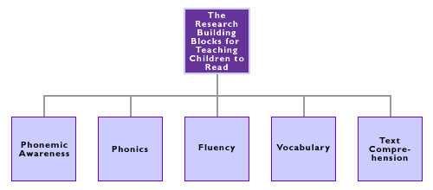
Programs with High Reading Proficiency
(National Reading Panel, 2000)

Slide 9
Principles for Promoting Inclusive Literacy Practices
Maintain High Expectations
Provide Models of Literate Behavior (Peer to Peer)
Elicit Students’ Perspectives (Use Preferred Interests)
Promote Diversity as a Positive Resource -- LRE
Adopt “Elastic” Instructional Approaches (e.g. Pacing)
Use Flexible Grouping Strategies
Differentiate Instruction

Slide 10
Methods to Enhance Literacy “Elastic” Procedures
Visual supports, maps, and supplemental materials / instruction
Priming for background knowledge
Peer – mediated instruction
Use of high interest materials
Engaging learners before, during and after reading
Use of Interactive books and PPT
Carnahan & Williams, 2010;
Carnahan, Williams & Haydon, 2009; Brown, Oram-Cardy & Johnson, 2013

Slide 11
Reading Instruction and Assessment within a Multi-Tiered System of Support (MTSS)
Intensive Individualized
Interventions
Few
Micro-Level
Sensitive to Small
Changes Over Time
Targeted Interventions
Meta-Level (2-3X per mo)
Progress Monitoring
(e.g. CBM)
Some
Universal Interventions
Macro-Level
Annual Assessment
(e.g. M-STEP; NWEA)
All
UNIVERSAL DESIGN FOR LEARNING
(Johnson & Street, 2013)

Slide 12
The DANGER of in Relying on Macro Assessment for Students with ASD

Slide 14
“Because assumptions, rather than proper assessment and screening, are frequently made about their (i.e. Students w/ ASD) cognitive and communication functioning, they are often excluded from literacy experiences.”
(Quality Literacy Instruction for Students with ASD;
Carnahan & Williamson, Eds., 2010)

Slide 15
ENHANCED ASSESSMENT

Slide 16
Look for Word Recognition FIRST Many students with ASD learn whole word. If you find they already have word recognition skills, no need to go back to letter skills. (Kluth, P. & Chandler-Olcott, 2008).

Slide 17
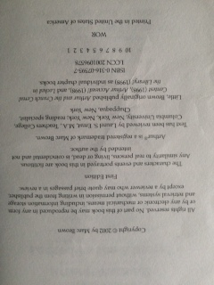
Look for ANY Evidence of Print Knowledge

Slide 18
Investigate…Investigate…Investigate
Consider speaking vs. non-speaking
Individualize (e.g. use preferred interests)
Use Interest Areas
Get Parental Input

Slide 19
Katie and Disney

Slide 20
Russell and Fast Food

Slide 22
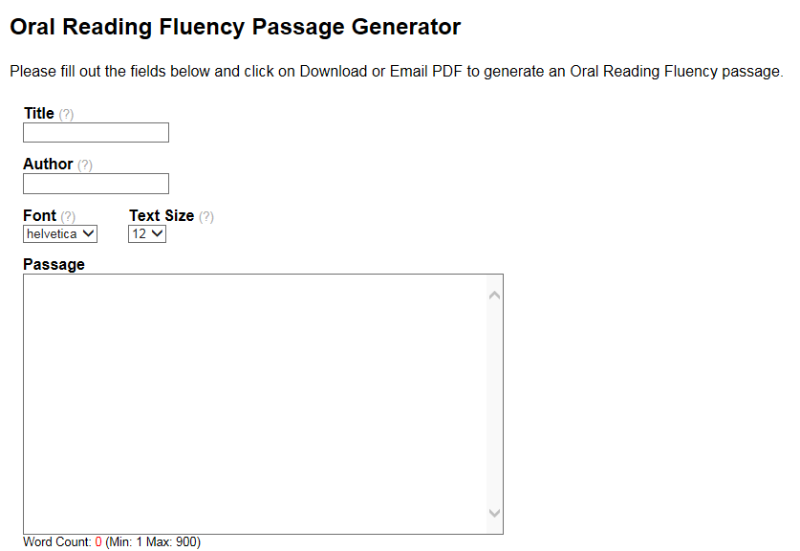
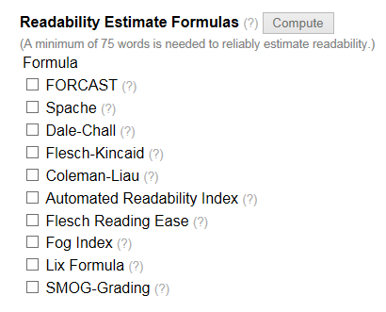
Match Evidence with READABILITY http://www.interventioncentral.org/teacher-resources/oral-reading-fluency-passages-generator

Slide 23
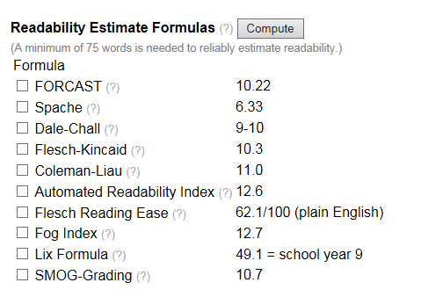
Women’s Health

Slide 24
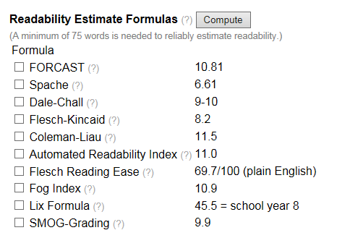
Better Homes and Gardens

Slide 25
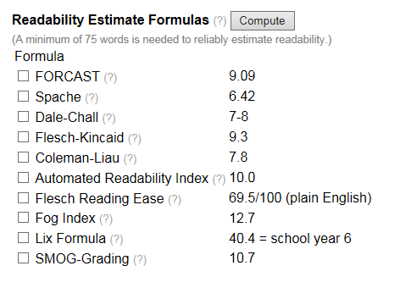
Fitness

Slide 26
The Top 10: Characteristics of ASD that Impact LITERACY
Theory of Mind / Emotional Reciprocity
Restricted Interests & Motivation
Joint Attention & Social Engagement
Executive Function
Central Coherence
Literal Thinking
Repetitive Patterns of Behavior
Pragmatics
Language & Communication
Prior Knowledge

Slide 27
Interrelatedness of Characteristics Selection of Top Examples

Slide 28
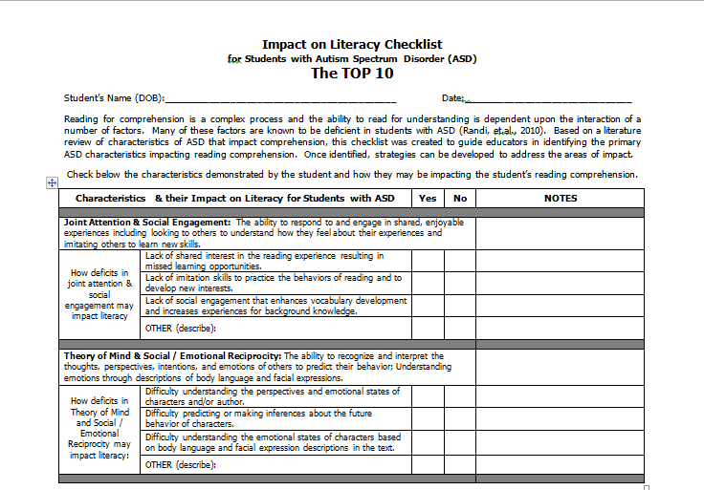
ASD Impact on Literacy Checklist The TOP 10

Slide 29
Characteristics of ASD that Impact Literacy Joint Attention & Social Engagement
Joint Attention & Social Engagement: The ability to respond to and engage in shared, enjoyable experiences including looking to others to understand how they feel about their experiences and imitation others to learn new skills.
How deficits in joint attention & social engagement may impact literacy | Lack of shared interest in the reading experience resulting in missed learning opportunities.
 | Lack of imitation skills to practice the behaviors of reading and to develop new interests.
 | Lack of social engagement that enhances vocabulary development and increases experiences for background knowledge.
 | OTHER (describe):

Slide 30
Characteristics of ASD that Impact Literacy Theory of Mind & Social Emotional Reciprocity
Theory of Mind & Social / Emotional Reciprocity: The ability to recognize and interpret the thoughts, perspectives, intentions, and emotions of others to predict their behavior; Understanding emotions through descriptions of body language and facial expressions.
How deficits in Theory of Mind and Social / Emotional Reciprocity may impact literacy: | Difficulty understanding the perspectives and emotional states of characters and/or author.
 | Difficulty predicting or making inferences about the future behavior of characters.
 | Difficulty understanding the emotional states of characters based on body language and facial expression descriptions in the text.
 | OTHER (describe):

Slide 31
Characteristics of ASD that Impact Literacy Central Coherence
Central Coherence: Understanding the central tenets of a passage and creating meaning from text details; the ability to integrate details in order to understand the “big picture” of a passage.
How deficits in central coherence may impact literacy | Over-focus on minor, irrelevant or concrete details in the passage thus missing the main idea(s) or overall purpose of the text.
 | Comprehending all the rote facts in the passage but not blending
 | Difficulty connecting information at the paragraph or chapter level.
 | OTHER (describe):

Slide 32
When asked to tell about the picture, the fourth grader replied, "deer." Do you see it?

Slide 33
Characteristics of ASD that Impact Literacy Executive Function
Executive Function: The ability to organize information and thoughts for coherency, self-monitor for comprehension, and execute plans of action.
How deficits in executive functioning may impact literacy | Difficulty suppressing irrelevant background knowledge and shifting meaning to different contexts.
 | Making irrelevant connections between contexts, concepts, or relationships.
 | Difficulty organizing and planning the reading experience (e.g. timelines for reading long texts) and self-monitoring for understanding (meta-cognition).
 | OTHER (describe):

Slide 34
Characteristics of ASD that Impact Literacy Restricted Interests and Motivation
Restricted Interests & Motivation: Abnormally intense preoccupation with specific interest areas or activities which impact motivation to read non-preferred text or results in getting stuck on words or phrases.
How intense interests and motivation can impact literacy | Intense focus on specific preferred interest areas so does not engage in reading in non-preferred text or results in getting stuck on words or phrases.
 | Gets stuck reading only certain words, phrases, or sections in text.
 | Fails to monitor for comprehension (meta-cognition) due to focus on preferred interests and topics.
 | OTHER (describe):

Slide 35
Characteristics of ASD that Impact Literacy Prior Knowledge
Prior Knowledge: The ability to apply relevant background knowledge to make global and abstract connections in text.
How deficits in applying prior knowledge can impact literacy | Difficulty accessing and applying relevant background knowledge in order to understand the context or situation in text.
 | Difficulty with word meanings (semantics) in context of the text.
 | Difficulty with comprehension of text requiring a lot of background social knowledge and social experiences (e.g. novels) versus those that require limited social understanding (e.g. technical text).
 | OTHER (describe):

Slide 36
Characteristics of ASD that Impact Literacy Literal (vs. Abstract) Thinking
Literal (vs. Abstract) Thinking: Focus on factual information such as events and actual objects or people in the text and an absence of focus on concepts and generalizations often confused by a lack of understanding idioms, irony, figures of speech, innuendo, and sarcasm.
How literal vs. abstract thinking can impact literacy | Difficulty understanding figurative language (e.g. metaphors) and use of idioms, irony, innuendo, sarcasm.
 | Difficulty ignoring irrelevant factual information in text and missing context cues and information that enhances understanding.
 | Applying only one meaning to a word and failure to use context cues to recognize a different meaning is necessary.
 | OTHER (describe):

Slide 37
Characteristics of ASD that Impact Literacy Pragmatics
Pragmatics: The ability to understand language and communication in social contexts and this predict character intentions and behaviors.
How deficits in pragmatics can impact literacy | Difficulty understanding perspectives or intentions based on the narration of characters and context cues.
 | Focus on concrete details in narrative text (e.g., what a character said specifically) rather than focus on conversation and context cues to gain an understanding of plot and character development.
 | Difficulty making inferences about characters’ emotions and perspectives based on subtle cues or context in text.
 | OTHER (describe):

Slide 38
Characteristics of ASD that Impact Literacy Language, Communication & Vocabulary
Language, Communication & Vocabulary: The ability to understand the complexities of language, communication, and vocabulary to comprehend text.
How deficits in language, communication & vocabulary can impact literacy | Difficulty with communication skills that impact ability to answer questions or demonstrate knowledge
 | Difficulty understanding vocabulary nuances (e.g. homographs (words spelled the same with more than one meaning) or homophones (words pronounced the same but with different meanings)).
 | Difficulty understanding pronouns used to represent previously identified persons, objects, or groups.
 | OTHER (describe):

Slide 39
STRATEGIES
Characteristics & their Impact on Literacy for Students with ASD |  | Yes | No | If yes, reference comprehension strategies listed for each characteristic.
Joint attention & Social Engagement: The ability to respond to and engage in shared, enjoyable experiences including looking to others to understand how they feel about their experiences and imitating others to learn new skills.
How deficits in joint attention & social engagement may impact literacy | Lack of shared interest in the reading experience resulting in missed learning opportunities. |  |  | Shared Storybook Reading: Building Young Children’s Language and Emergent Literacy Skills (Ezell & Justice, 2005) Attending Strategy: Determine current attending baseline behavior by observing how long the child attends in two separated shared-reading sessions. Establish an attending goal measured in either length of time or number of pages Select an attractive book with limited print on a topic that may be preferred interest and incorporates flaps, moveable parts or textures. During shared reading session, the adult should read the book with enthusiasm and animation. When the target time or page has been reached, verbal praise should be provided to the child (e.g. “You did a great job listening to the story!” and then the session should be ended. A record of the child’s attending time (measured in either minutes or number of pages read) should be maintained. The use of this strategy can be continued until the child is able to attend to the entire reading of one brief storybook.

Slide 40
PRIMARY SOURCES
Barr, Blachowicz, C. Bates, A. Katz, C. Kaufman, B. (2013). Reading Diagnosis for Teachers: An Instructional Approach (6th Ed.). Pearson.
Brown, H., Oram-Cardy, J. & Johnson, A. (2013). A Meta-Analysis of the Reading Comprehension Skills of Individuas on the Autism Spectrum. Journal of Autism and Developmental Disorders, 43, 932-955.
Carnahan, C. & Williamson, P. (Eds) (2010). Quality Literacy Instruction for Students with Autism Spectrum Disorders. AAPC.
Carnahan, C. Williamson, P. & Haydon, T. (2009). Matching Literacy Profiles with Instruction for Students on the Spectrum: Making Reading Instruction Meaningful. Beyond Behavior, 19, 10-16.
Consortium on Reading Exellence (2008). Assessing Reading: Multiple Measures. Arena Press.
Honig, B. Diamond, L. & Gutlohn. L, (2013). Teaching Reading Sourcebook. Arena Press.
Iland, E. (2011). Drawing a Blank: Improving Comprehension for Readings of the Autism Spectrum. AAPC

Slide 41
PRIMARY SOURCES
Intervention Central (2015) Curriculum-Based Measurement Warehouse.
http://www.interventioncentral.org/curriculum-based-measurement-reading-math-assesment-tests.
Johnson, K. & Street, E. (2013). Response to Intervention and Precision Teaching: Creating Synergy in the Classroom. Guildford Press.
Kluth, P. & Chandler-Olcott, K. (2008). A Land We Can Share: Teaching Literacy to Students with Autism. Brooks.
Knight, V. & Sartini, E. (2015). A Comprehensive Literature Review of Comprehension Strategies in Core Content Areas for Students with Autism Spectrum Disorder. Journal of Autism and Developmental Disabilities, 45, 1213-1229.
Randi, J, Newman, T. & Grigorenko, E. (2010). Teaching Children with Autism to Read for Meaning: Challenges and Possibilities. Journal of Autism and Developmental Disorders, 40(7), 890-902.
University of Oregon Center on Teaching and Learning (2015). U/O DIBELS Data System. https://dibels.uoregon.edu/ .

