Slide 1
Planning for 3rd Grade Literacy Success in the Context of the 3rd Grade Reading Law
August 2017

Slide 2
Number of 3rd Graders Assessed
107,178
3rd Graders
2014-15 School Year

Slide 3
Of 3rd Graders Assessed
53,481
were not proficient in English Language Arts on MSTEP

Slide 4
M-STEP ELA Spring 2016
3rd Grade
54% of students were NOT advanced or proficient
That is 58,303 students.
46% of Michigan 3rd graders were advanced or proficient
Notes:
Or, if we look at only the students who score in the lowest category on MSTEP, we have 31,499 (29%) students statewide who are significantly struggling.

Slide 5
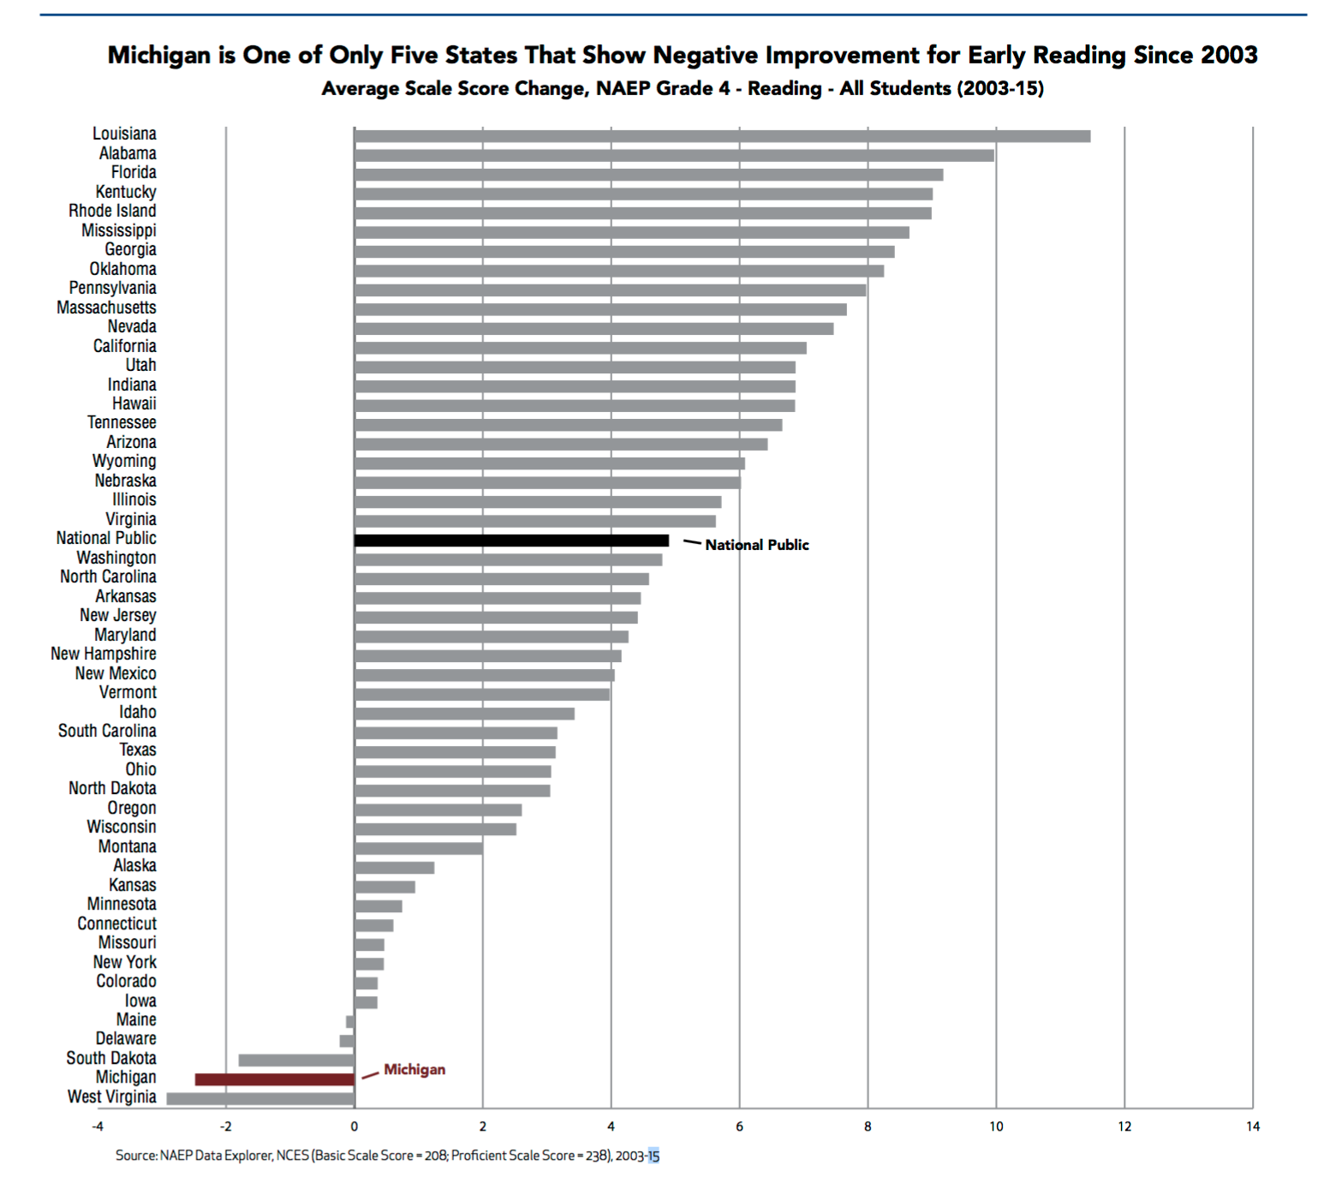

Slide 8
Michigan is faced with a challenge
We must improve learning outcomes for our students.
“Literacy knowledge and skills developed in kindergarten through third grade predict later literacy achievement. Classroom instruction can have an enormous impact on the development of literacy knowledge and skills.” Essential Instructional Practices in Early Literacy K-3

Slide 9
“Be unsatisfied-disturb the comfortable in Michigan literacy.” -Dr. Nell Duke

Slide 11
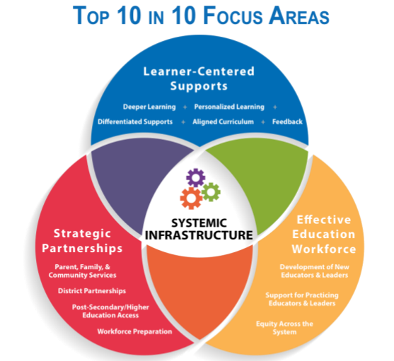

Slide 12
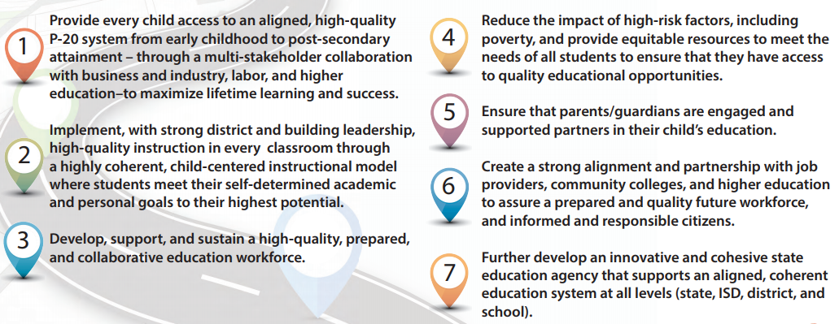
Top 10 in 10

Slide 13
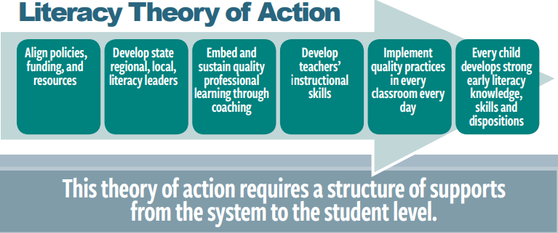

Slide 14
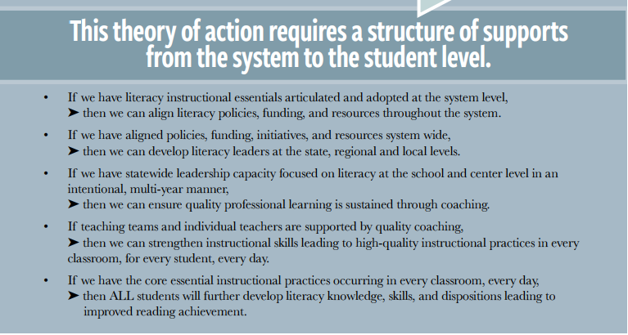

Slide 15
3rd Grade Reading Law
District Responsibilities- Beginning 2017-2018
Assessment to Inform Instruction
Core Reading Instruction
Reading Intervention
Reading Improvement Plans
Professional Development (based on data)
Literacy Coaching
Encouraged to offer Summer Reading Camps

Slide 16
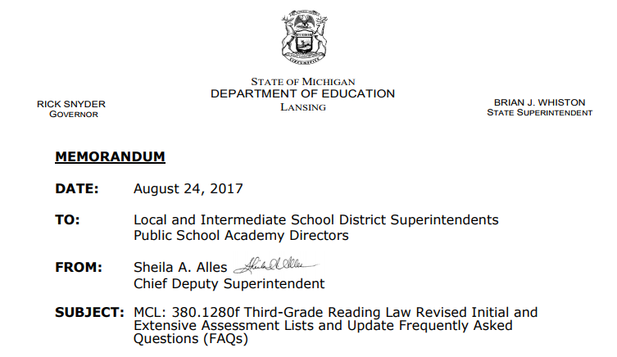
Assessment to Inform Instruction Beginning 2017-18
For all K-3 students:
To inform instruction and intervention needs
Assess progress toward a growth target
Within the 1st 30 days of the school year
At least 3 times per school year
Guidance and support for the 2018-2019 year is expected to be released in March 2018.

Slide 17
Assessment to Inform Instruction
Use of Current Versions: When purchasing assessments, districts are reminded that assessment authors regularly make improvements to assessments and update based on research. Districts are strongly advised to use the most up to date versions of an assessment.
Provide Appropriate Training: Any staff who are expected to collect and use assessment data must be trained, observed, and provided with feedback to ensure the accurate collection and use of data.

Slide 18
Assessment to Inform Instruction
Use and Collect Assessment Data: Assessment data provide a powerful tool for educators as they make decisions about instruction. Data from assessments should be combined with Formative data including observation, peer- and self-reflection, and instructional evaluation of student performance.
Align Assessments, and Tasks to the Rigor of the State Assessment: The state assessment sets a high standard for rigor and assesses in formats that may be new to some educators. All Michigan educators are encouraged to familiarize themselves with the state assessment to understand what students will be expected to know and do. M-STEP Resource Page

Slide 19
Assessment to Inform Instruction
Create an Appropriate Local System of Assessments:Districts may not need to cease using assessments not on the approved list. If other assessments are being used effectively and resulting in enhanced decision making that improves students’ performance, districts may continue use of those assessments in addition to the approved initial and extensive Assessment systems that they have selected. Additional support for creating a local system can be found on the District Assessment Inventory website.

Slide 20
Assessment to Inform Instruction
Predict Student Performance: Inherent in any assessment will be some measurement error. Therefore, any single assessment is unlikely to perfectly predict which students will perform well on a given outcome assessment (e.g., M-STEP). Selecting assessments that have strong technical adequacy and ensuring appropriate in-district use will help to ensure the resulting data can lead to decisions that will support all students. It is also appropriate that districts use all assessments and Formative Practices to identify/predict student achievement.

Slide 21
3rd Grade Reading Law
District Responsibilities- Beginning 2017-2018
Assessment to Inform Instruction
Core Reading Instruction
Reading Intervention
Reading Improvement Plans
Professional Development (based on data)
Literacy Coaching
Encouraged to offer Summer Reading Camps

Slide 22
Core Reading Instruction
Reading Programs
Beginning 2017-2018
Intended to ensure all students are reading at grade level by the end of 3rd grade:
Identifies and addresses the pupil’s reading deficiency
Screens and monitors the progress of each pupil’s reading skills
Comprehensive, evidence-based core reading instruction

Slide 23
Definition of program
[Late Latin programma, from Greek]
a plan or system under which action may be taken toward a goal

Slide 24
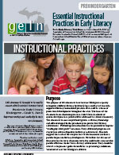
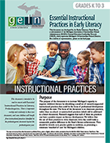
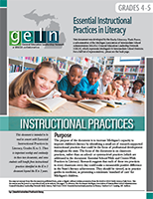
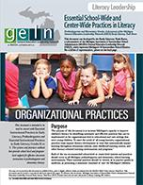
Core Reading Instruction
In progress: Literacy Essentials
6-12

Slide 25
The legislation itself is not rich enough to succeed in improving results.
Executive Summary
Theory of Action
Essential Schoolwide Practices in Literacy
Essential Coaching Practices
Pre K Essential Instructional Practices
K-3 Essential Instructional Practices
4-5 Essential Instructional Practices
Supporting Early Literacy Instruction and Science Instruction

Slide 26
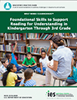
IES Practice Guides and Rubrics
What is aligned, misaligned, and missing?

Slide 27
3rd Grade Reading Law
District Responsibilities- Beginning 2017-2018
Assessment to Inform Instruction
Core Reading Instruction
Reading Intervention
Reading Improvement Plans
Professional Development (based on data)
Literacy Coaching
Encouraged to offer Summer Reading Camps

Slide 28
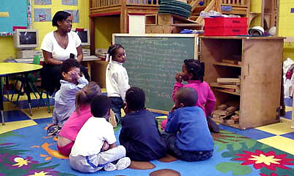
3rd Grade Reading Law
Reading Interventions – To meet the Minimum
Develop the ability to read at grade level
Develop the reading components of phonemic awareness, phonics, fluency, vocabulary, and comprehension
Systematic, explicit, multisensory, and sequential
Implemented during regular school hours in addition to regular classroom instruction

Slide 29
3rd Grade Reading Law
Reading Interventions- English Language Learner
Ongoing assessments that provide actionable data
Instruction in phonemic awareness, phonics, comprehension, fluency, and academic vocabulary
Development of strategies such as modeling, guided practice, and comprehensive input
Encourage:
Instruction in native language
Opportunities for speech population
Feedback in native language

Slide 30
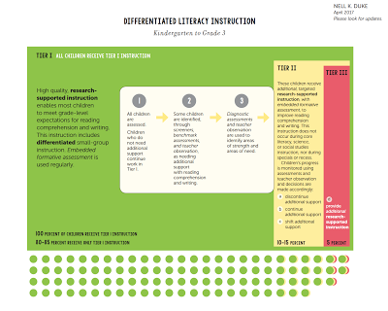
Research Alignment
Regardless of intervention, children’s engagement is a top priority, instruction is responsive, and the child has considerable time to apply what is being learned during reading and writing instruction.

Slide 31
3rd Grade Reading Law
District Responsibilities- Beginning 2017-2018
Assessment to Inform Instruction
Core Reading Instruction
Reading Intervention
Reading Improvement Plans
Professional Development (based on data)
Literacy Coaching
Encouraged to offer Summer Reading Camps

Slide 32
Reading Improvement Plans
Beginning 2017-2018
All K-3 students who show a reading deficiency using the district assessment system will need an Individualized Reading Improvement Plan
Written notice provided to parents/guardians
Within 30 days of identified deficiency

Slide 33
Reading Improvement Plans
Beginning 2017-2018
Working with Our Partners:
Creating Useful and Meaningful Individual Reading Improvement Plans as Tool to Support Student Literacy Growth
The Form
The Companion Document
Guidance

Slide 34
1.
COMPLIANCE VS. COMMITMENT
Why are we doing this?
Notes:
Leveraging the Law

Slide 35
Yes, we have to! But why wouldn’t we?
Legislative Mandate
Improving Literacy Instruction and Student Growth
Work of Early Literacy Task Force
Focus our Energy Here!

Slide 36
There is nothing better for helping a child learn to read...
IRIPs don’t teach kids; Programs don’t teach kids;
teachers do, and teachers are capable of making magic happen for kids.
Than a well trained,
well informed teacher committed to the child’s success!

Slide 37
2.
THE IRIP FORM
This form meets the requirements in the legislation and is directly connected to the companion document

Slide 38
WHAT IT IS
WHAT IT IS NOT
Student focused
Strengths focused
Data Informed
Process Orientated
An option for use
Compliance focused
Deficit focused
A checkbox for completion of the IRIP
Required to use

Slide 39
It's the process that matters!
Teachers collect AND carefully analyze and synthesize the data
Teams use rich dialogue and deep questions to create a meaningful IRIP for a student
The IRIP is implemented,successes and challenges assessed, and the plan/data is reviewed often
Notes:
Output: The form

Slide 40
How it works?
Specific second page
Language
Hyperlinks

Slide 41
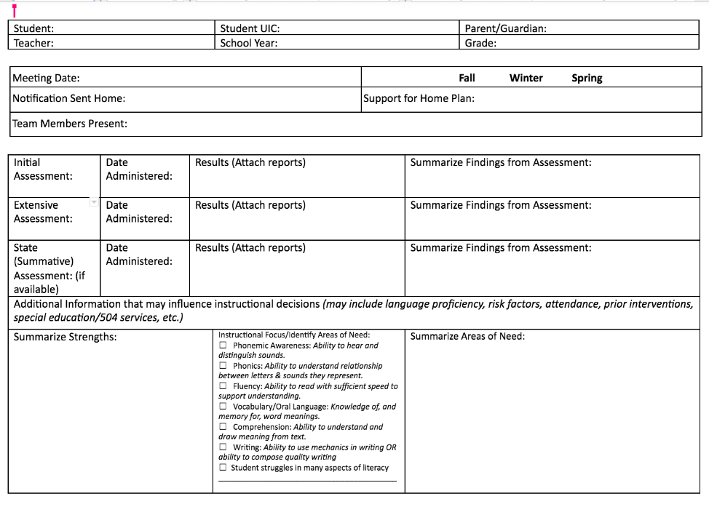
What you will see that likely won’t see on other forms...
Notes:
Intentional use of language...teacher and strengths

Slide 42
3.
THE COMPANION DOCUMENT
Making sense of it all through the PROCESS!

Slide 43
It's the process that matters!
The IRIP is implemented, successes and challenges assessed, and the plan/data is reviewed often
Teachers collect AND carefully analyze and synthesize the data
Teams use rich dialogue and deep questions to create a meaningful IRIP for a student
Notes:
Output: The form

Slide 44
PURPOSE
This document was developed to support districts, schools, school leaders, teams, classroom teachers, and IRIP instruction providers as they strive to improve literacy development for students who are underperforming K-3 AND as an avenue to:

Slide 45
Purpose
~Create a meaningful process for improving teaching and learning for each child using the K-3 Essential Instructional Practices in Early Literacy as a foundation for literacy instruction in every school
~Challenge the language of the legislation (deficit) and focus on building a growth mindset among teachers, teams, and families with regard to students who exhibit the greatest needs in literacy development
~Build a tool that will support the implementation of Individual Reading Instruction Plans (IRIPs) and shift the focus from COMPLIANCE to COMMITMENT
~Build principal and teacher capacity to understand effective literacy instruction AND to provide the explicit supports to students on IRIPs
~Foster collaboration in schools through the use of guiding questions and protocols for discussion
~Emphasize the focus of effective literacy practices over programs and “silver-bullet” options of improving literacy development and achievement

Slide 46
WHAT IT IS
WHAT IT IS NOT
A DRAFT
An option for use with any IRIP form
Easy to read/use
A collection of information, resources, and guiding questions to support
FINISHED
Mandatory or recommended
A hard to read/use guide
A list of recommended programs

Slide 47
TABLE OF CONTENTS
Key Sections
IRIP:
DIALOGUE
Introduction, Purpose, and User Information
A guide to the IRIP - Page 1
A guide the the IRIP - Page 2
GUIDING QUESTIONS
Given your observations ….? What might these ….? When looking at these ….?

Slide 48
3rd Grade Reading Law
District Responsibilities- Beginning 2017-2018
Assessment to Inform Instruction
Core Reading Instruction
Reading Intervention
Reading Improvement Plans
Professional Development (based on data)
Literacy Coaching
Encouraged to offer Summer Reading Camps

Slide 49
Planning With Our Partners for 3rd Grade Literacy Success

Slide 50
Planning With Our Partners for 3rd Grade Literacy Success
Professional Learning to Grow Capacity Around the Statewide Literacy Initiative
Michigan Literacy Leader Workshops
ISD Coaching Intensives
Early Childhood Specialist Institutes
ISD Coaching Institutes
District/ISD Coaching Institutes: 2017

Slide 51
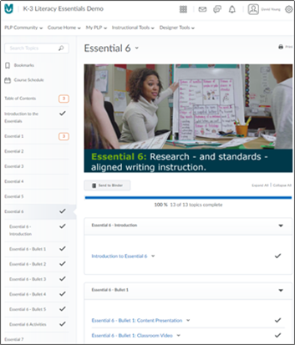
Planning With Our Partners for 3rd Grade Literacy Success
ISD Coaches
Literacy Networks
One-on-one work with teachers and as literacy leaders around the Early Literacy Essential Instructional Practices
Professional Learning Modules
In Development
Focused on Essentials
Featuring Michigan educators

Slide 52
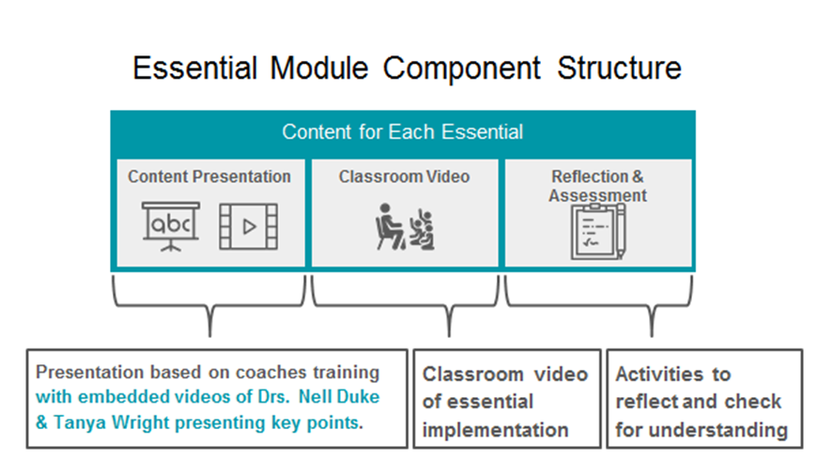
Planning With Our Partners for 3rd Grade Literacy Success

Slide 53
3rd Grade Reading Law
District Responsibilities- Beginning 2017-2018
Assessment to Inform Instruction
Core Reading Instruction
Reading Intervention
Reading Improvement Plans
Professional Development (based on data)
Literacy Coaching
Encouraged to offer Summer Reading Camps

Slide 54
Literacy Coaching Beginning 2017-18
MDE’s Responsibilities (In Progress) | District Responsibilities
Recommend or develop an early literacy coaching model with the following features: Ongoing Professional Development: Reading components and the Essentials Administering and utilizing assessment data Differentiated instruction and intensive intervention | Utilize at least early literacy coaches provided through the ISDs

Slide 55
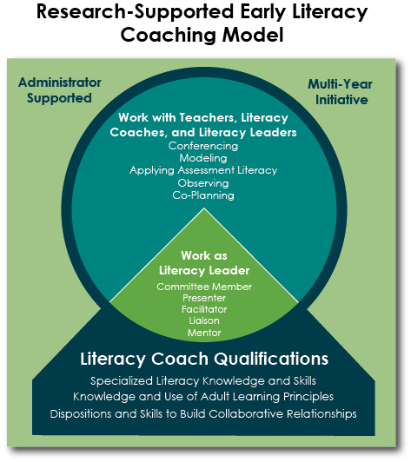

Slide 56
3rd Grade Reading Law
District Responsibilities- Beginning 2017-2018
Assessment to Inform Instruction
Core Reading Instruction
Reading Intervention
Reading Improvement Plans
Professional Development (based on data)
Literacy Coaching
Encouraged to offer Summer Reading Camps

Slide 57
Summer Reading
“No More Summer Reading Loss”

Slide 58
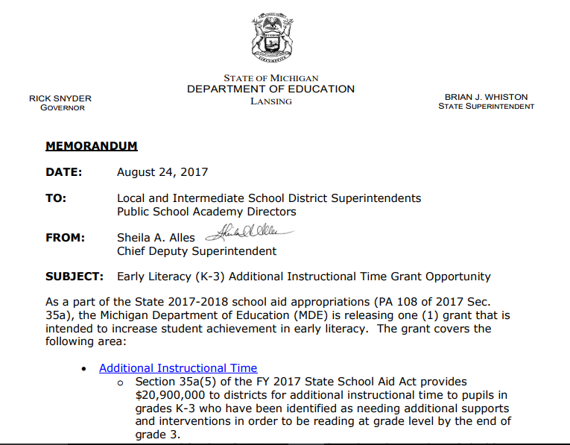
Summer Reading
Additional Instructional Time Grant
Section 35a(5) of the FY 2017 State School Aid Act provides $20,900,000 to districts for additional instructional time to pupils in grades K-3 who have been identified as needing additional supports and interventions in order to be reading at grade level by the end of grade 3.

Slide 59
3rd Grade Implications

Slide 60
3rd Grade Reading Law
Reading Intervention Programs for Grade 3– Students Exhibiting Deficiency Include:
Evidence-based and proven results in accelerating pupil reading achievement within the same school year
More dedicated time than the previous school year
Daily targeted small group or 1-to-1 reading intervention based on needs
Delivered by teacher, tutor or volunteer with specialized reading training
Provided before school, during school hours, but outside regular English language arts classroom time
“Read at Home” plan
Guardian training workshops and regular home reading
Schools and Districts must:
Document efforts by the school to engage the pupil’s guardian
Document any dissenting opinions in IRIP

Slide 61
3rd Grade Reading Law
3rd Grade Students in 2019-2020 (Current 1st Graders)
Shall ensure that a pupil, whose guardian has been provided notification, is not enrolled in grade 4 until one of the following occurs:
Achieves a reading score that is less than 1 grade level behind on the grade 3 state English Language Arts assessment
Demonstrates a grade 3 reading level through performance on an alternative standardized reading assessment approved by the superintendent of public instruction
Demonstrates a grade 3 reading level through a portfolio demonstrating competency in all grade 3 state English Language Arts standards
Other must-knows:
Incoming students younger than 10 years of age must demonstrate grade 3 reading level
Only requires repeating 3rd grade once

Slide 62
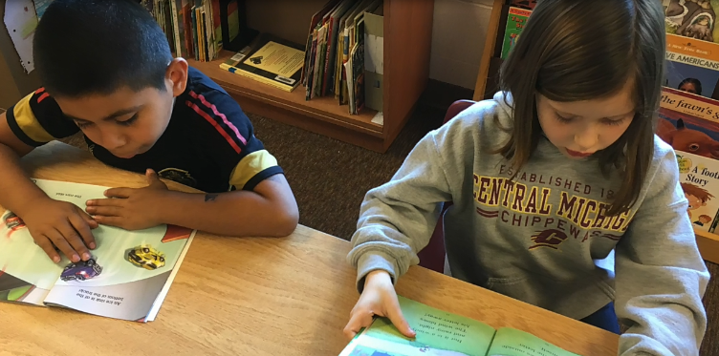
3rd Grade Reading Law
Timelines
May 23rd or 14 days after finished, scoring is provided to CEPI
June 1st or 14 days after getting scores, CEPI tells guardians by certified mail:
State has determined that the pupil may be required to be retained
Guardian has the right to request a ‘good cause exemption’
30 days after the date of notification by CEPI
Must direct the request to the district in which student intends to enroll in 4th grade
Right to request a meeting with school officials
.

Slide 63
3rd Grade Reading Law
Good Cause Exemption
May be granted for one of the following:
Individualized education program or with a section 504 plan
The individualized education program team or section 504 coordinator makes the decision
Limited English proficient student
Less than 3 years of instruction
Received intensive intervention for 2 or more years and was previously retained
Continuously enrolled in current district for less than 2 years and evidence they were not provided with an appropriate Individual Reading Improvement Plan
Requested within the time period and in the best interest of the student

Slide 64
3rd Grade Reading Law
Good Cause Procedure
After request or the teacher’s own initiative
Grade 3 teacher submits a recommendation along with documentation that indicates that an exemption applies to the pupil
Review and discuss the recommendation and make a determination in writing
Superintendent/chief administrator’s decision is final
Communicated to the parent or legal guardian at least 30 days before the first day of school

Slide 65
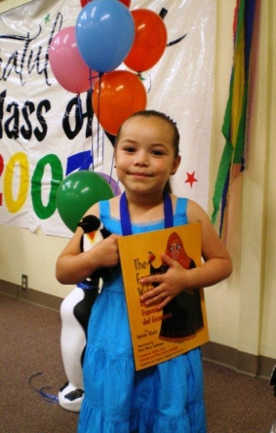
3rd Grade Reading Law
Exemptions other than Good Cause
Both of the following:
Proficient in all subject areas assessed on the grade 3 state assessment other than English language arts
Proficient in science and social studies as shown through a pupil portfolio and as determined by the teacher who provided the grade 3 instruction to the pupil in science and social studies

Slide 66
3rd Grade Reading Law
Students not Promoted (and some that have been)
District shall provide a reading intervention program that is intended to correct the pupil’s specific reading deficiency
Effective instructional strategies and 1 or more:
Assigned to highly effective teacher of Reading
Highest evaluated grade 3 teacher in the school
Reading specialist
Evidenced-based reading programs
Reading instruction and intervention for the majority of contact time that incorporates grade 4 standards in other areas
Tier two or three intervention with progress monitoring
“Read at Home” plan

Slide 67
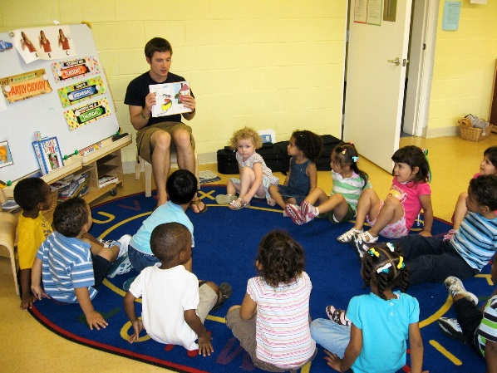
3rd Grade Reading Law
Staffing Plan
Beginning June 4, 2019 – If cannot meet guideline, then need to post a plan by August 15, 2019, which includes:
Description of the criteria that will be used to assign a pupil who has been identified as not proficient in English language arts to a teacher
Credentials or training held by teachers currently teaching at the school
How the district will meet the requirements under this section

Slide 68
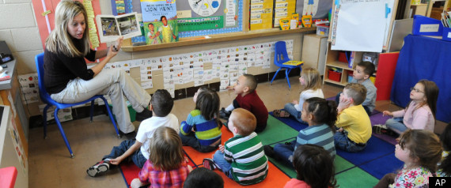
3rd Grade Reading Law
Reporting Requirements
Retention Report to CEPI:
Beginning in 2020, not later than September 1, 2020
Number of pupils retained in grade 3
Number of pupils promoted to grade 4 due to a “Good Cause Exemption”

Slide 69
When the school bell rings on day one and all our students are in their seats, we will hold the future of this nation and this world in our hands. Whatever we do will have lasting implications, not only on the lives of those students, but also on the lives of all of those whom they come in contact with. So then, the question that we should ask ourselves should not be,
“How can I make this work?” The question must be,
“How can I afford not to make this work?”
~Wendy Kopp, One Day, All Children

Slide 70
Questions?
Laural Triebel
MDE, OEII Curriculum and Instruction
triebell@michigan.gov
Lisa Brown
MDE, OFS Special Populations
brownl30@michigan.gov

