Slide 1
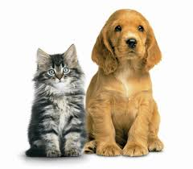
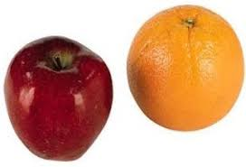
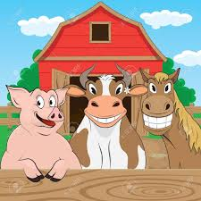
Alike and Different
Talk about how things are similar/alike as well as how things are different.
How is a dog like a cat? How is a dog different from a cat?
How is a horse like a cow? How is a cow different from a pig?
Notes:
cat /dog
horse/cow
apple/orange

Slide 2
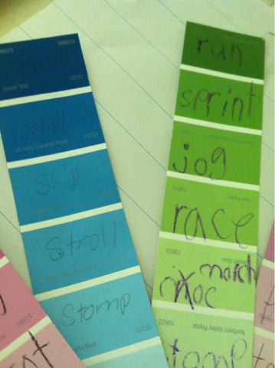
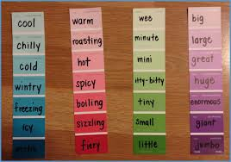
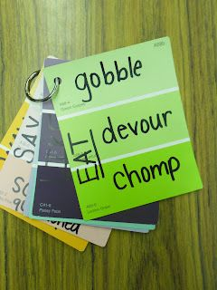
Variety of words
Use a variety of words to describe feelings and emotions. For example, your child says he/she is happy. You can validate that by saying, “I’m so glad you are so joyful today! You sure look happy!”
Notes:
Get paint sample cards and write a simple word at the top. Help parents make cards with simple and complex words. You could teach parents how to google synonyms
Big, gigantic, large, huge, etc.
Said, yelled, shouted, etc.

Slide 3
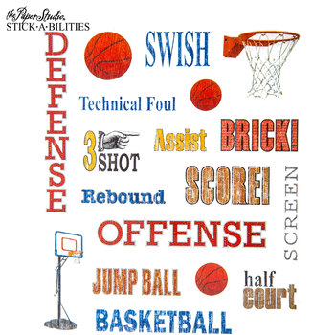
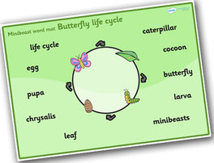
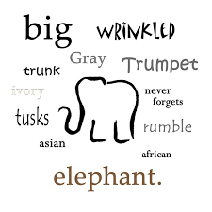
Topic/Category Words
When you read a book about a topic, ask them to tell you all the words related to it.
Ex: If you read a book about a dog, your child might say dog, puppies, toy, food, play, and leash.
Add other words to help expand upon what he/she says.

Slide 4
Word Collecting
Have each family member be on the lookout for interesting words that they heard that day.
At dinner or bedtime, have everyone share the word they collected and tell what they think it means.
If the child shares an incorrect meaning, guide him/her to the correct meaning.
Try to use some of the words in conversation.

Slide 5
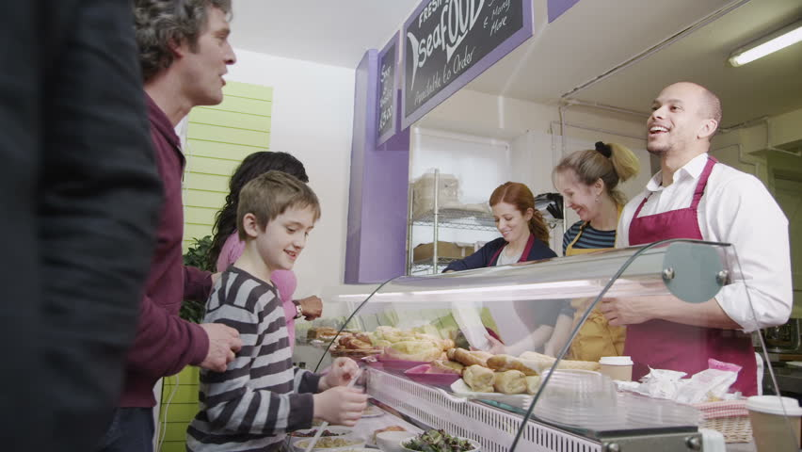
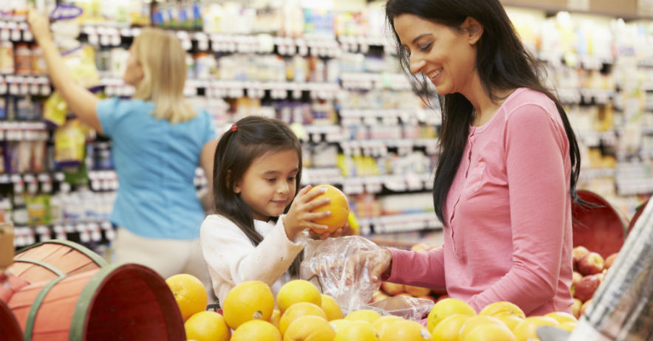
Local Places
Trips to everyday places build vocabulary.
Discuss what you are doing and seeing
Ask your child what they are doing and seeing
Notes:
Discuss what you are doing and seeing as you are going through the store. For example, “I’m here in the bakery. I can find donuts, cookies, and bread.” Ask your child, “What else do you think I could find here?”

Slide 6
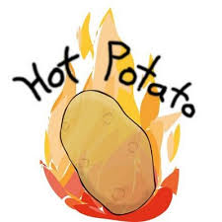
Hot Potato Vocabulary Builder
Number of Players 2-10
Write categories on slips of paper (pets, clothes, family members, animals, foods, etc.) and place in a cup
Form a circle and draw a category slip from the cup
Toss a small, round object to a player (a tennis ball, an orange, or a real potato)
The player who is holding the "hot potato" says a word that fits in the category.
After naming a word that fits in the category the player gently tosses the object to the next player.
A player is “knocked” out of the round when they don’t name a word that fits in the category.
The game continues until one player is left — that player is the winner.
Notes:
Facilitator can model this activity

Slide 7
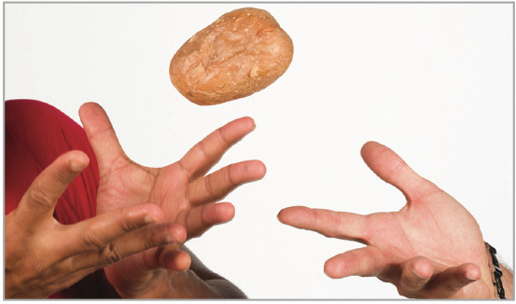
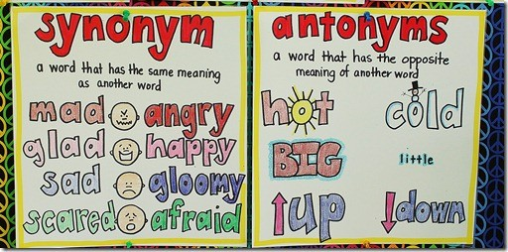
Hot Potato Game : Synonyms
Choose a word, and then your child has to think of another word that means the same thing. Take turns until neither player can think of another word. For example, you may say, “Cold,” and your child might say, “Freezing.” Then you could say, “Chilly,” and so on. Try the game again with antonyms (opposites).

Slide 8
For Introducing New Vocabulary and Working with Words
Provide a simple, kid-friendly definition for the new word:
“Enormous means that something is really, really big.”
Provide a simple, kid-friendly example that makes sense within their daily life:
“Remember that really big watermelon we got at the grocery store? That was an enormous watermelon!”
Encourage your child to develop their own example:
“What enormous thing can you think of? Can you think of something really big that you saw today? That's right! The bulldozer near the park was enormous! Those tires were huge.”

Slide 9
More Helpful Tips
Keep your new words active within your house.
Over the next few days and weeks, take advantage of opportunities to use each new vocabulary word in conversation.
Use a variety of words to describe feelings and emotions.
You can validate that by saying, “I’m so glad you are so joyful today! You sure look happy!”
When you read a book about a topic, ask him/her to tell you all the words related to it.
Ex: If you read a book about a dog, he/she might say dog, puppies, toy, food, play, and leash. Add other words to help expand upon what he/she says.
Talk about how things are similar/alike as well as how things are different.
Ex: How is a dog like a cat? How is a dog different from a cat?

